Slide 1
Big Bang ! What is Metaverse ?
Zhang Pinxuan

Slide 2
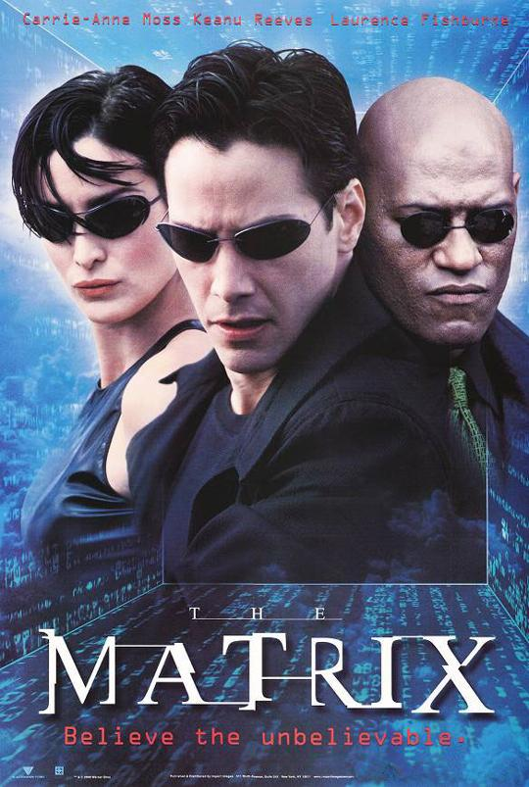

What is Metaverse?
Metaverse: A symbol

Slide 3
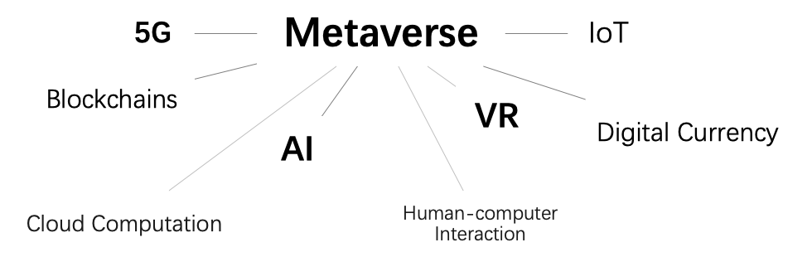
What is Metaverse?
Metaverse: Multi-disciplinary cross-fertilization

Slide 4
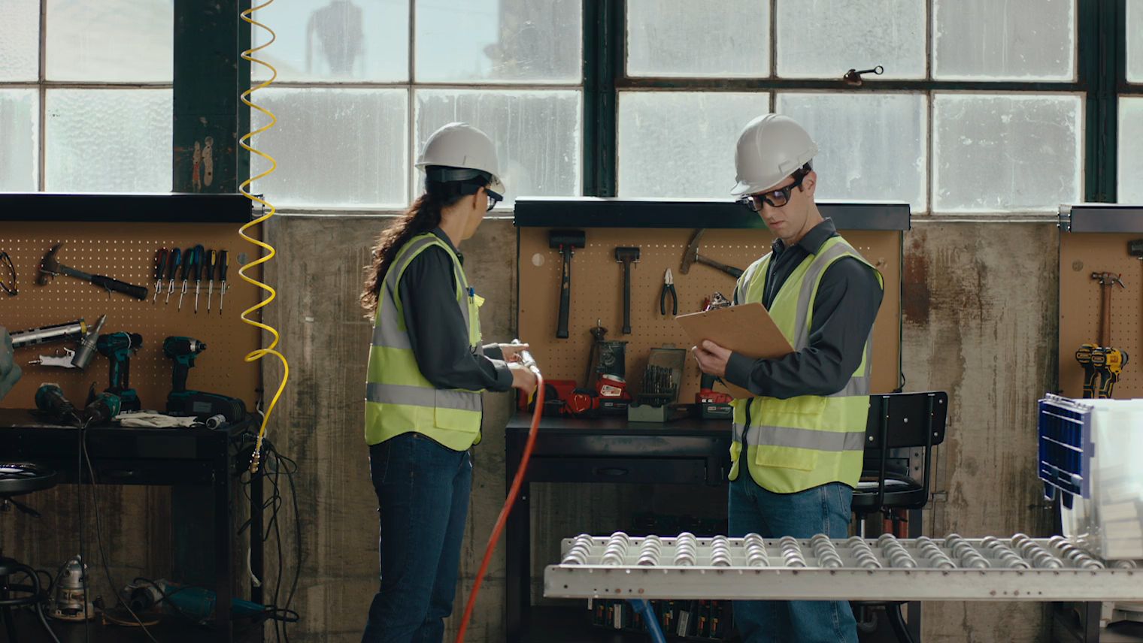
What is Metaverse?
Cores
Interaction
Vision and hearing
Smell, taste and touch
Consciousness

Slide 5
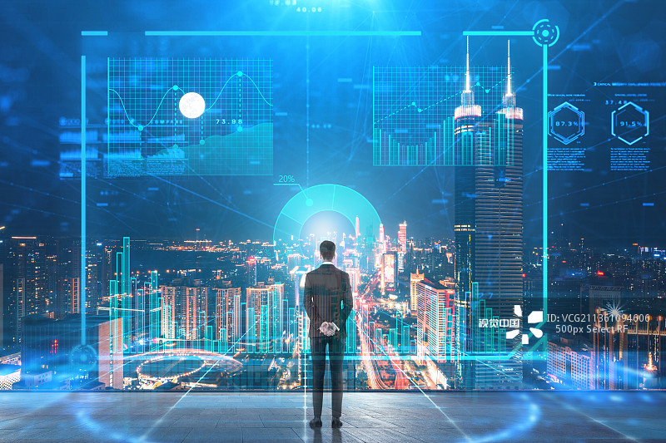
What is Metaverse?
Cores
Connection
Inter-individuals
Human to society
Ultimate goal
A virtual universe

Slide 6
Big Bang ! What is Metaverse ?
Thank you!

